Slide 1

National Committee
on Housing and Health
Initial Meeting
October 10, 2012 1:00 - 2:30 PM
National
Healthy Housing
Standard

Slide 2
Meeting Objectives and Agenda
Introduce and acquaint members
Review and discuss the purpose of and process for developing the standard
1:05 Welcome
Dr. Tom Vernon and Dr. Georges Benjamin
1:10 Introductions
1:20 Background, Role of Committee, Process Rebecca Morley and Jane Malone, National Center for Healthy Housing
1:40 Discussion and Decisions
2:00 Next Steps

Slide 3
Introductions - Committee Members
Meri-K Appy
Dr. Georges Benjamin
Dr. Gail Christopher
Henry Cisneros
Dr. Carlos Dora
Dr. Ruth Etzel
David Fukuzawa
Dr. Lynn Goldman
Moises Loza
Nic Retsinas
Dr. Megan Sandel
Steve Thomas
Dr. Tom Vernon (Chair)

Slide 4
Background and Need

Slide 5
The Link between Housing and Health
Notes:
The role of housing as a contributor to health has been known for decades, while new agents and pathways continue to be discovered and explored. ^{[2]}
In the early 1800s, the relation between housing conditions and health was recognized among public health practitioners in the United States and Europe and led to the rise of the sanitary reform movement. Slum clearance and improving the quality of housing and sanitation were important components of 19th and 20th century campaigns to control typhus, tuberculosis, and other infectious diseases. Interest in housing as a determinant of health has fluctuated in response to housing-related infectious disease outbreaks (e.g, cholera in New York City in the 1830s), social unrest and class conflict, industrial interest in maintaining a healthier workforce, and economic downturns leading to crises in housing availability and quality. ^{[3]}

Slide 6

Health in the Late 19th Century
Tuberculosis, Typhoid, Cholera
Light, Fresh Air, Reduce Crowding, Improved Sanitation.
Disease Rates Declined
Notes:
Lessons for Public Health Officials, Architects and Planners:

Slide 7
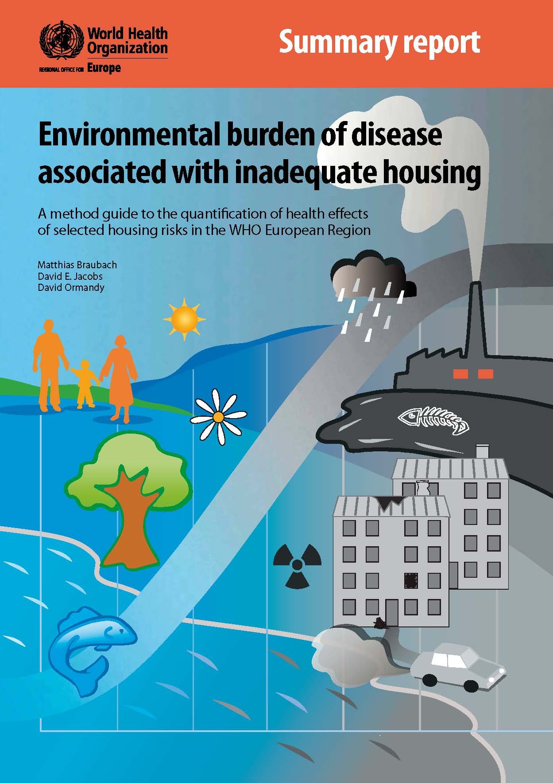
Health Consequences of
Inadequate Housing are Substantial
Indoor dampness/mold
Home injury
Crowding
Indoor cold
Traffic noise
Second-hand smoke
Radon
Lead
CO
Formaldehyde
Indoor smoke from solid fuel
Housing quality
www.euro.who.int/__data/assets/pdf_file/0003/142077/e95004.pdf
Notes:
Summary: The report provides evidence that the health consequences
of inadequate housing are substantial. Improving
housing in a way that removes or at least minimizes the
negative impact on health and safety and promotes a
healthier living environment is good for the residents
and beneficial for society. Reducing the burden of
responding to the demands on the health system
attributable to inadequate housing should therefore be
seen as an obvious public health priority, but also as
something that makes economic sense.

Slide 8
Race/ethnicity of people living in homes with severe and moderate physical problems
Source: American Housing Survey, 2005
Notes:
People of color are more than two times more likely to live in homes with moderate problems. And people of color are more likely than their white counterparts to live in housing with severe problems. Common types of problems include lack of complete plumbing, unvented room heaters as the primary heating equipment, and multiple upkeep problems such as water leakage, open cracks or holes, broken plaster, or signs of mice.

Slide 9
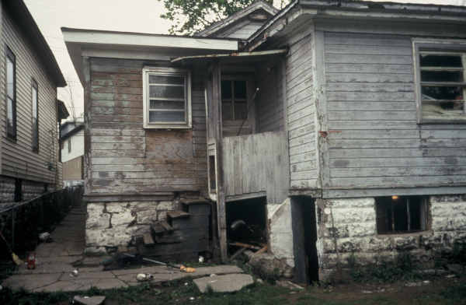
Fragmented Housing Policies
Federally-Owned and Assisted Housing
  HUD Housing Quality Standards (rental)
  HUD Minimum Property standards (mortgage insurance)
Privately-Owned Housing
  Property Maintenance Code – International Code Council
  State laws (e.g. health code) and local ordinances
  Some jurisdictions have no housing maintenance requirements or sanitary code

Slide 10
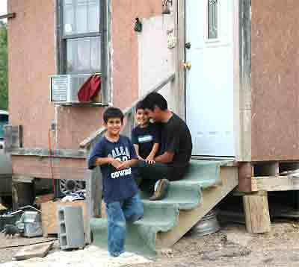
Standards Outdated
Recommended Health and Housing Standards
  Last updated 1986
HUD Housing Quality Standards
  Last update:
International Codes
  Health and safety changes often voted down
    E.g. lead-based paint, carbon monoxide, radon

Slide 11

Surgeon General’s Call to Action
“We must continue to work together across communities and the nation to ensure our homes are sited, designed, built, renovated, and maintained in ways that support the health of residents.”
Ron Sims, Former HUD Deputy Secretary
http://www.surgeongeneral.gov/topics/healthyhomes/index.html

Slide 12

State of the Nation’s Healthy Housing
www.nchh.org/Policy/State-of-Healthy-Housing.aspx
Notes:
12
Across metropolitan areas, rental properties tend to have more problems than owner occupied dwellings and central city housing tends to have more problems than housing outside the central city. Central city rental properties tend to be older and are more likely to be inhabited by lower income residents. There are exceptions to these trends; for example, cities such as Atlanta, Chicago, Detroit, Kansas City, Sacramento and Seattle have better quality rental properties in their central cities than in their surrounding areas.
The Metro Surveys of the AHS offer valuable information to help our cities focus resources on housing problems most affecting occupant health and safety. Unfortunately, these surveys have been underfunded and they are not being updated on the planned 6 year schedule. Restoration of funding is needed to give local governments the information needed to protect their residents.

Slide 13
Purpose and Objectives of Standard
Purpose
  To improve the quality of existing U.S. homes and reduce housing-related health disparities
Objectives
  Develop an attainable, enforceable, and practicable healthy housing standard
  Create an implementation plan to aid adoption

Slide 14
Role of Committee & Process

Slide 15
Key Players
American Public Health Association (APHA)
National Center for Healthy Housing (NCHH)
National Committee on Housing and Health
Technical Review Work Group

Slide 16
Characteristics of the Standard
Evidence-based: Supported by science
  To prevent disease and injury
  To improve health outcomes
Attainable, enforceable and practicable
Not a construction or rehab standard:
  focus on condition of occupied dwellings

Slide 17
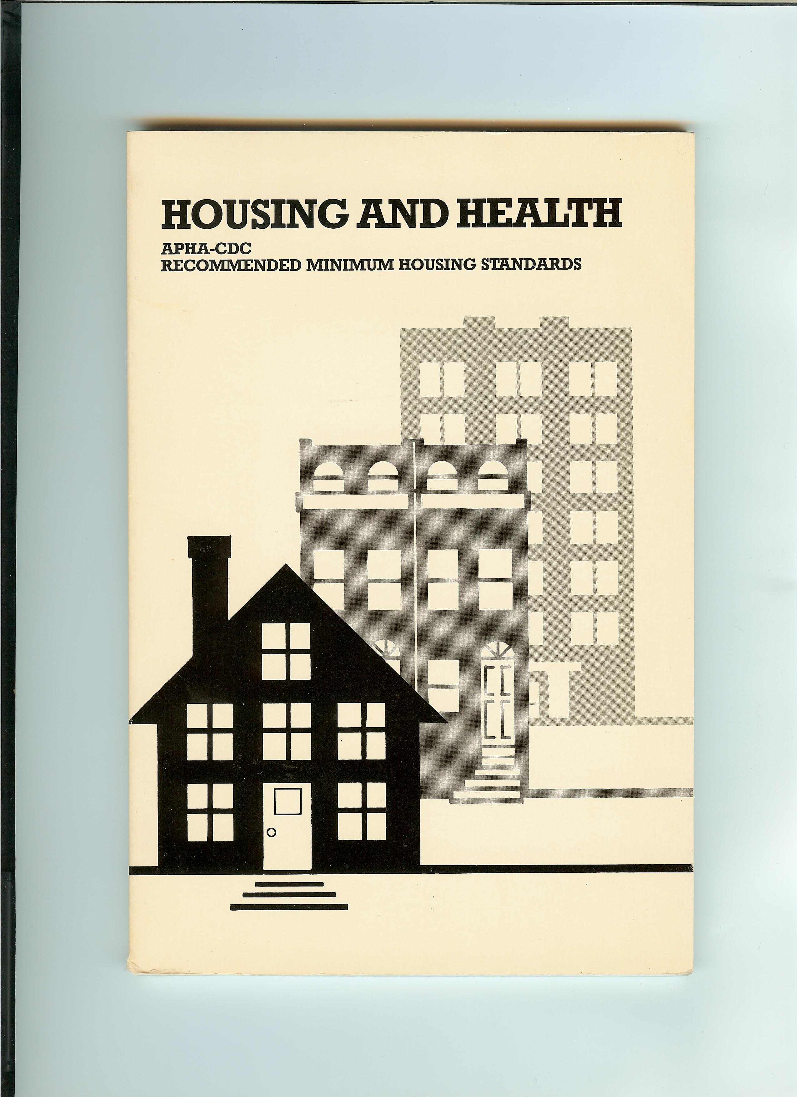
Foundational Document
Health-Protective
Model Ordinance
Property Owner and Occupant Responsibilities
Directed at Public Health Agencies

Slide 18
Building on a Historic US Dialogue
League of Nations Housing Commission -1936
Basic Principles of Healthful Housing -1939
American Housing Act: decent home suitable living environment for every family - 1949
Proposed Housing Ordinance - 1952
Recommended Minimum Housing Standards (APHA-CDC 1986)

Slide 19
The Standard’s Value Added
Model for local adoption
Model for federal adoption (e.g. HQS, ICC)
Standard of care for any home

Slide 20
Timeline
Task | Activities | Deadline
Provide Input, Adopt Strategy | Convene Committee | October 10, 2012
Key Constituent Outreach | Meet with Housing Industry, Federal Agencies | November 2012
Review of Legal Provisions | Expert Consultation | November 2012
Develop Standard | Technical Review Work Group (TRWG) Meetings Committee Meeting | December 2012 January 31, 2013
Obtain Stakeholder Input | Public Comment Period and Presentations | February 2013
Develop Final Version | Address Comments | April 2013
Committee Endorsement | Committee Meeting | May 15, 2013
Publication and Adoption

Slide 21
Key Process Points
National Committee on Housing and Health
  Convenes to Review Process and Plans (Oct)
Technical Review Work Group
  Conducts scientific review of staff draft (Nov/Dec)
Stakeholder Engagement
  Housing industry leaders/associations & Federal agencies (Oct & Ongoing)
Public comment (February)
Incorporate Comments (March/April)
Dissemination - May

Slide 22
National Housing and Health Committee Role
Feedback on Strategy and Process
  Credibility and Optics
  Dissemination
  Key Stakeholders
Involvement in Technical Work (as desired)
Two More Meetings – 1/31/13 and 5/15/13

Slide 23
Contact Information
Staff Lead: Jane Malone, jmalone@nchh.org, 202.280.1983
Chair: Dr. Thomas Vernon, vaxmd@
Technical Work Group Chair: Jim Krieger

Slide 24
Discussion and Decisions

